Slide 1
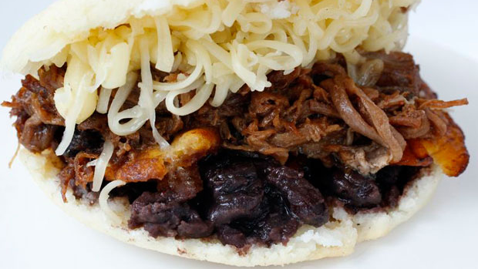
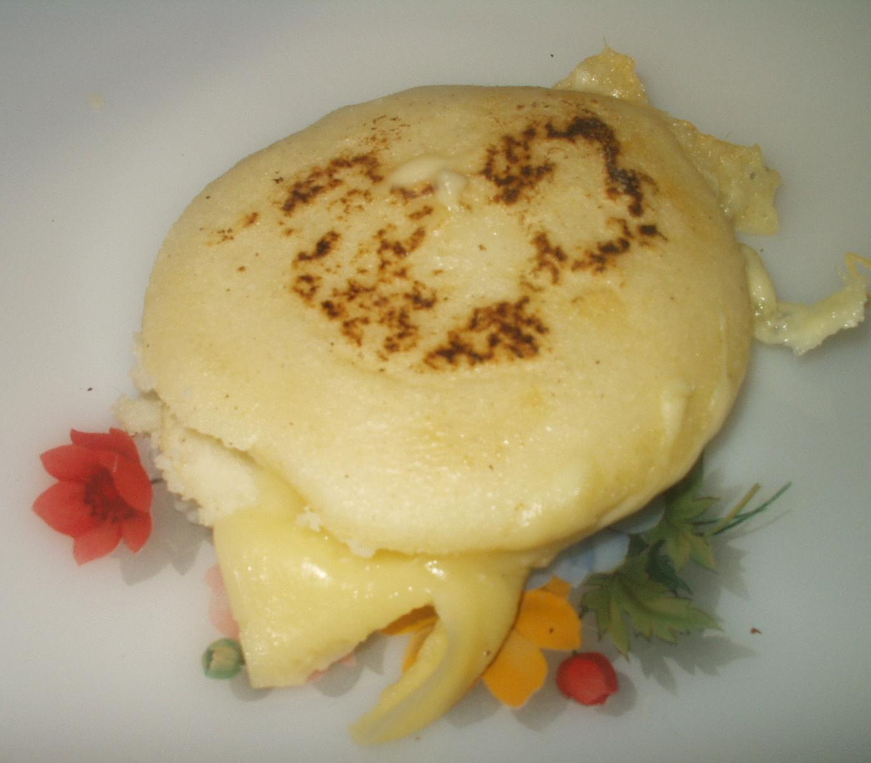
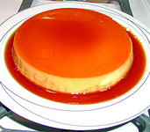
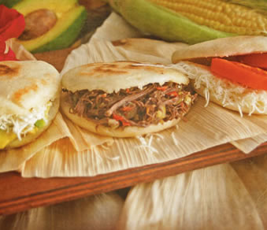
Mis Amigos Restaurante
Horario
Lunes – Sabado; 07:00 – 21:00
111 La Calle Libertad
Caracas, Venezuela 01234
555-555-5555

Slide 2
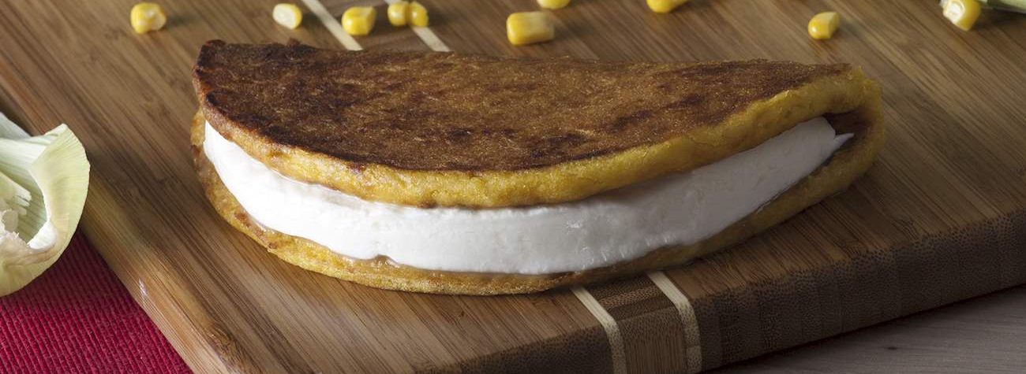
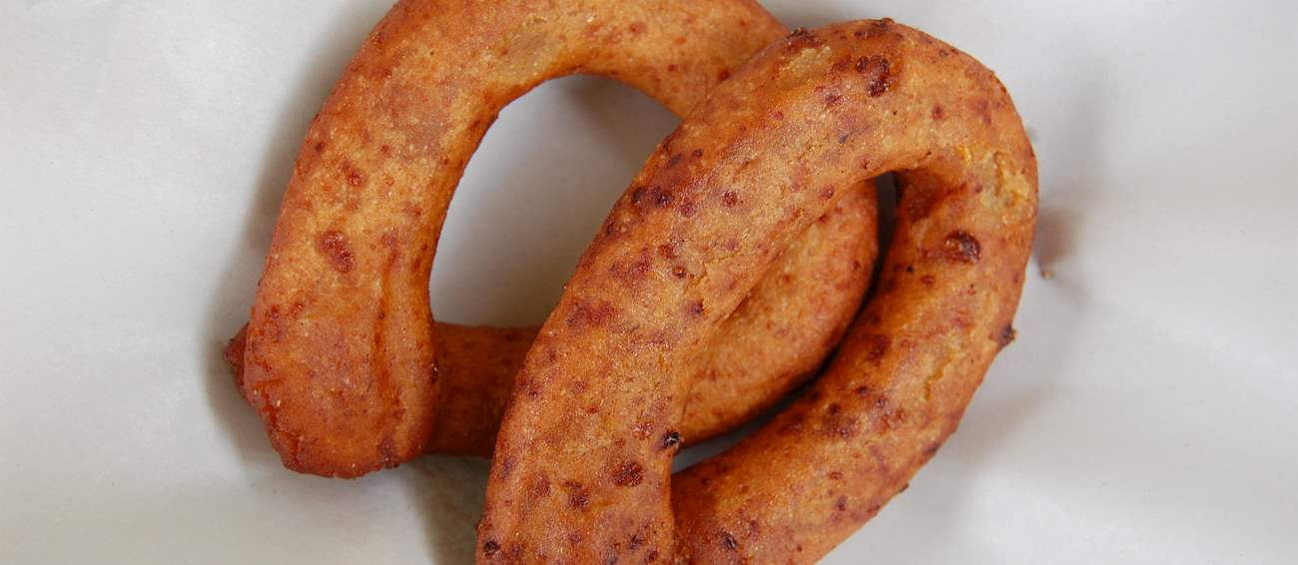
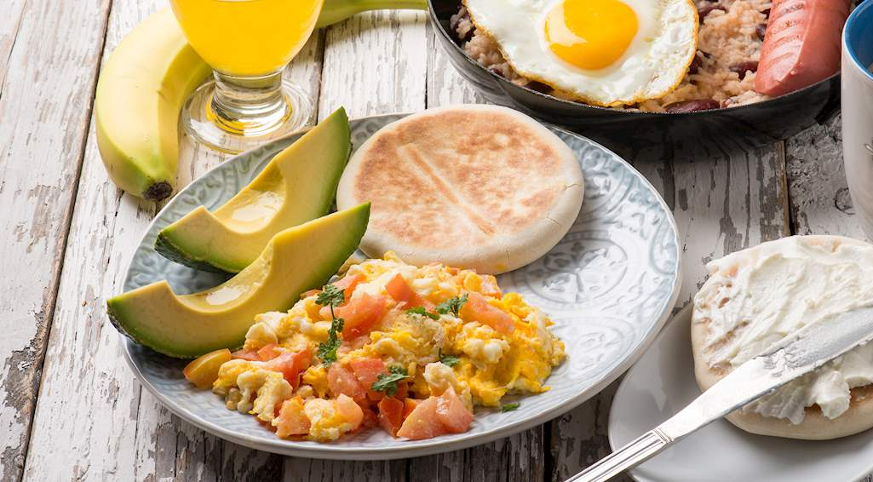
El Desayuno
Cachapa
Panqueques de
maiz con queso.
10 VEF
Mandoca
Hecho de maiz,
Platanos, azucar,
10 VEF
Perico
Huevos con verduras
8 VEF

Slide 3
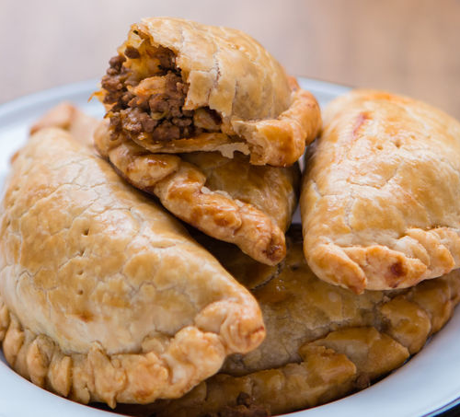
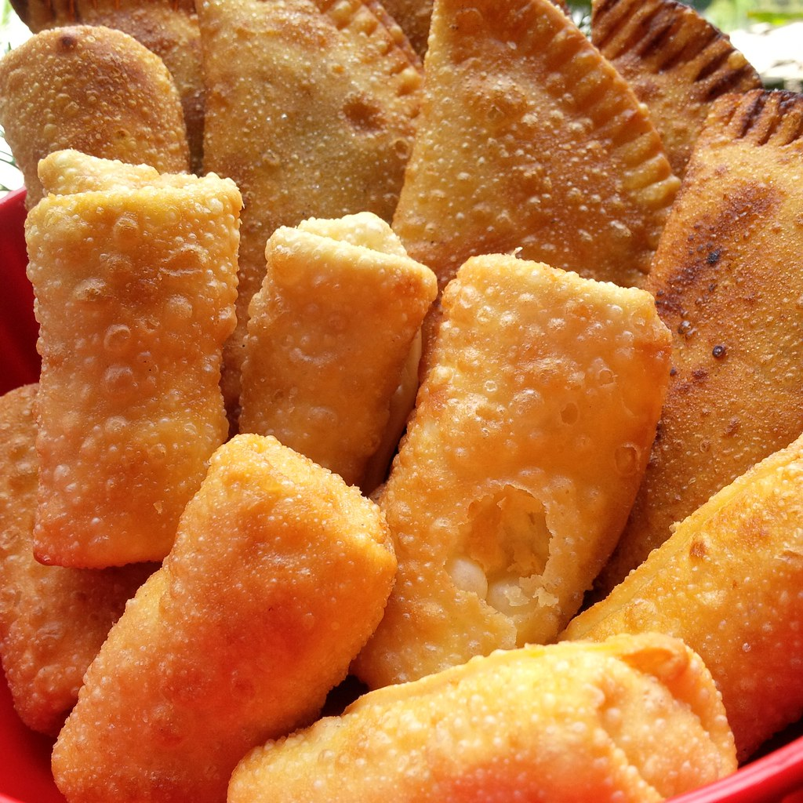
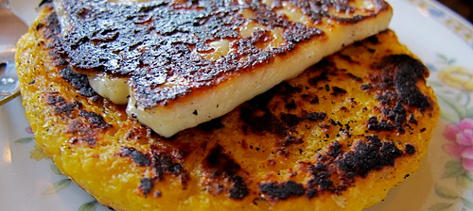
Los Aperitivos
Tequenos
Empanadas
Empanadas—Hecho de bistec, pollo 7 VEF
Arepas de Choclo—Hecho de maiz y llenado con queso 7 VEF
Tequenos---Fritos, llenados con queso 8 VEF
This Photo by Unknown Author is licensed under CC BY-SA
This Photo by Unknown Author is licensed under CC BY-NC-ND
Arepas de Choclo

Slide 4
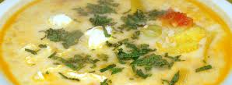
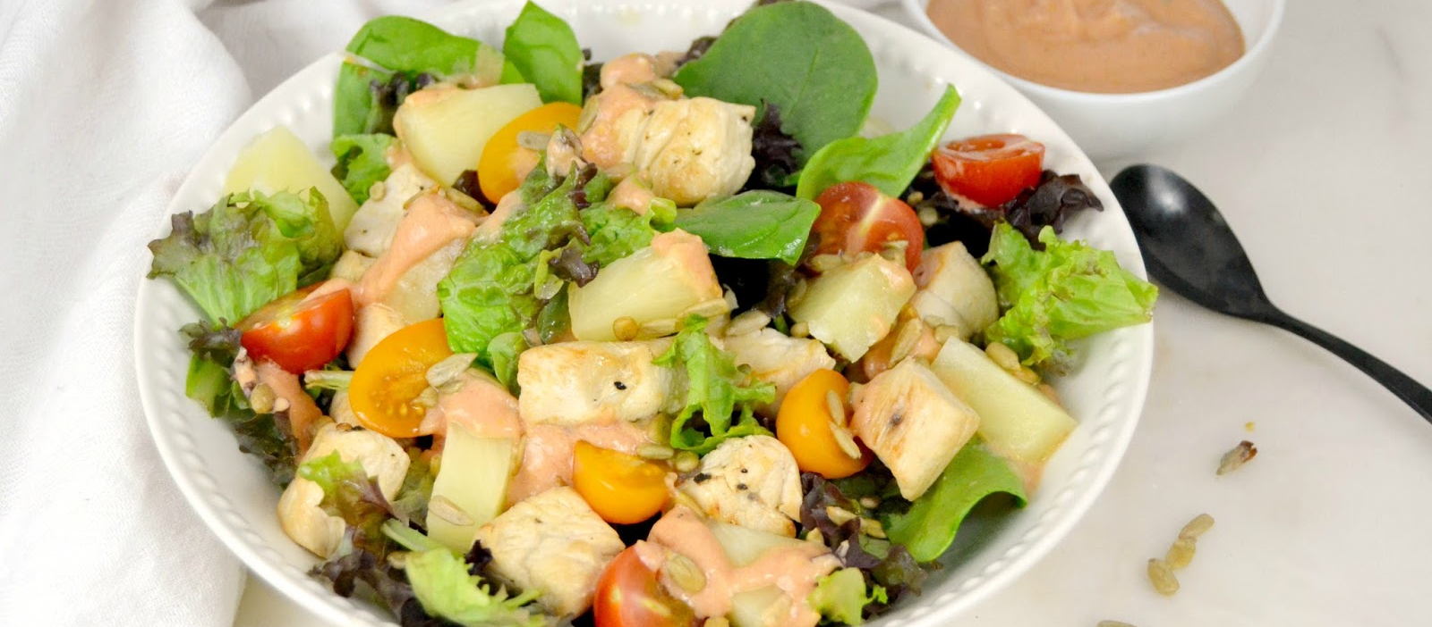
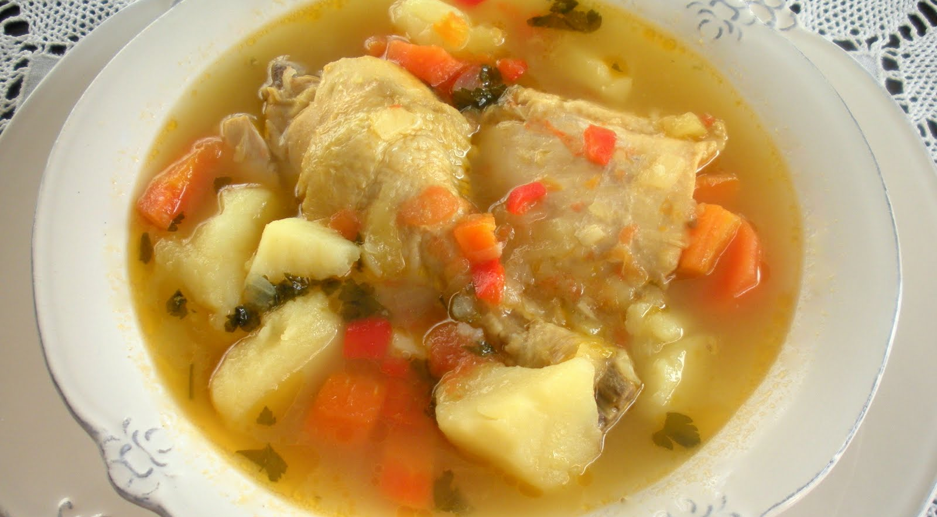
El Almuerzo
Pisca de Andina
Pescado, pollo, verduras, queso
16 VEF
Ensalada de pollo—
Lechuga, espinaca, tomates, aguacate, pollo
15 VEF
Hervido de gallina
Sopa de pollo, zanahorias, patata
16 VEF
This Photo by Unknown Author is licensed under CC BY-NC
This Photo by Unknown Author is licensed under CC BY-NC
This Photo by Unknown Author is licensed under CC BY-SA-NC

Slide 5
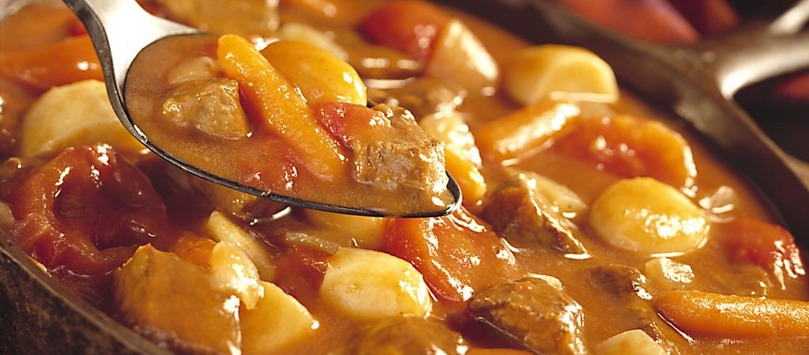
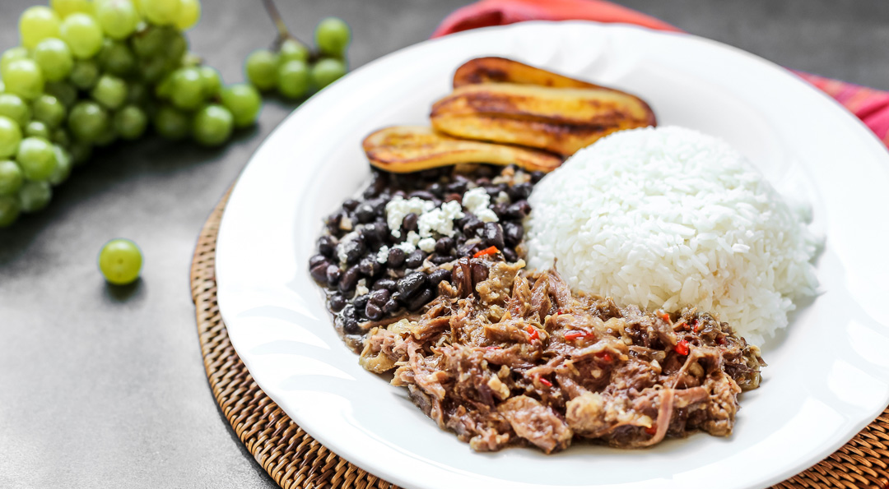
La Cena
Arepas—Con carne, aguacate, tomates,
y queso
15 VEF
Mondongo—
Sopa de verduras y pescado
16VEF
Pabellon Criollo
Bistec, arroz,
Frijoles negros
Platanos fritos
17VEF
This Photo by Unknown Author is licensed under CC BY-NC-ND
This Photo by Unknown Author is licensed under CC BY-NC-ND
This Photo by Unknown Author is licensed under CC BY-NC-ND

Slide 6
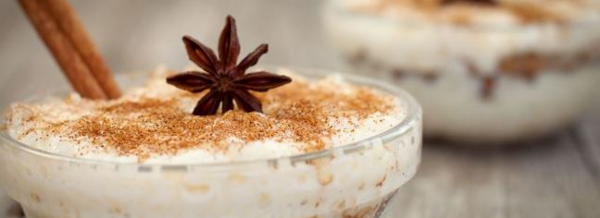
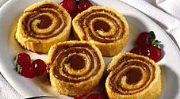
El Postre
Arroz con leche
Arroz, leche, azucar
9 VEF
Quesillo—
Flan venezolano, con
Leche
10 VEF
Pionono
Patel de brazo de reina con dulce de leche
8 VEF
This Photo by Unknown Author is licensed under CC BY-SA
This Photo by Unknown Author is licensed under CC BY-NC-ND
This Photo by Unknown Author is licensed under CC BY-SA

Slide 7
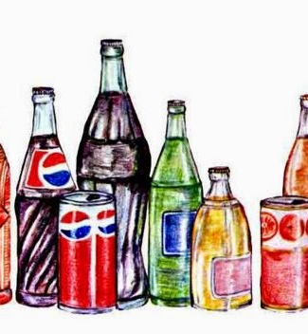
Las Bebidas
Leche 5 VEF
Jugo de naranja 5 VEF
Refrescos 5 VEF
Jugo de manzana 6 VEF
Agua 4 VEF
This Photo by Unknown Author is licensed under CC BY-NC-ND

Slide 8
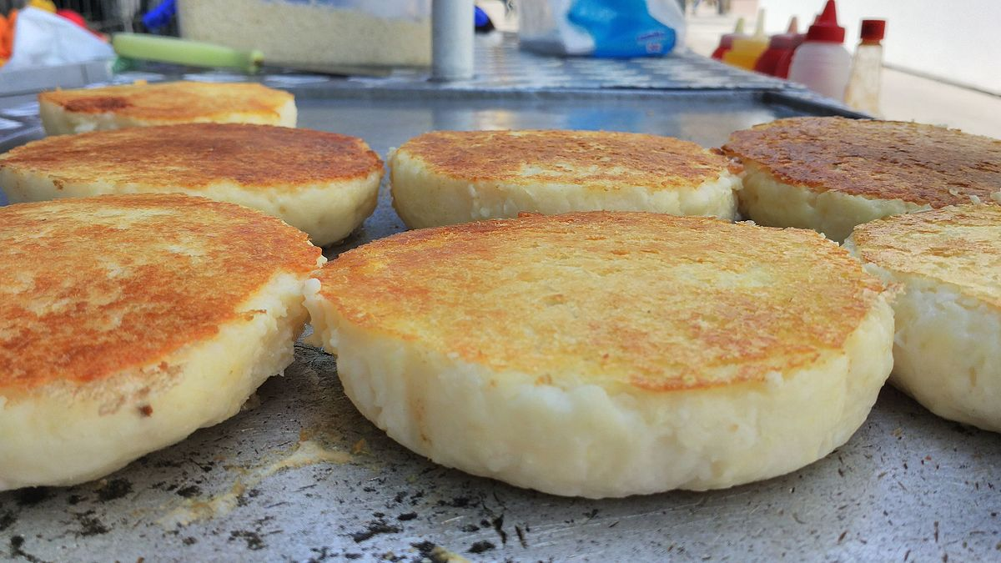
Senorita Fisher DPA Middle School Spanish Due 3/27/20
This Photo by Unknown Author is licensed under CC BY-SA

